Slide 1
HA/DR en Azure: ¿Cuál es la mejor opción para su sistema?
Gonzalo Bissio

Slide 2
Speaker
Gonzalo Bissio
SQL Engineering Team at Ernst & Young
MCSA 2012 - 2014- 2016 Database administration / MCSE: Data Management and Analytics.
Flamante y orgulloso papá de Pedrito.
Amo el mundo DBA tanto como al
Club Independiente y a Rocky Balboa.
Blog: sqlserverrules.wordpress.com
Email: gonzalobissio@Hotmail.com
Twitter: @Gbissio

Slide 3
HA/DR deployment architectures
Azure Only
Availability replicas
running across
multiple Azure
regions in Azure VMs
for disaster recovery.
Cross-region solution
protects against
complete site outage.
Replicas running in
same Azure Region
for HA.
Hybrid
Some availability
replicas running in
Azure VMs and other
replicas running on-
premises for cross-
site disaster recovery.
HA only, not DR
FCI on a two-node
WSFC running in
Azure VMs with
storage supported by
storage spaces direct.
For DR only /
Hybrid only
One server running in an Azure VM and the other running on-
premises for cross-
site disaster recovery.
Log shipping
depends on Windows file sharing, so a VPN connection between
the Azure virtual
network and the on-
premises network is
required.
Requires AD
deployment on DR
site.
On-prem or Azure
production databases
backed up directly to
Azure blob storage
for disaster recovery.
SQL 2019: Backup to
Azure with file
snapshots
Simpler BCDR story
Site Recovery makes
it easy to handle
replication, failover
and recovery for your
on-premises
workloads and
applications (not
data!).
Flexible replication
You can replicate on-
premises servers,
Hyper-V virtual
machines, and
VMware virtual
machines.
Eliminate the need
for secondary
Native support for
SQL Server data files
stored as Azure blobs

Slide 4
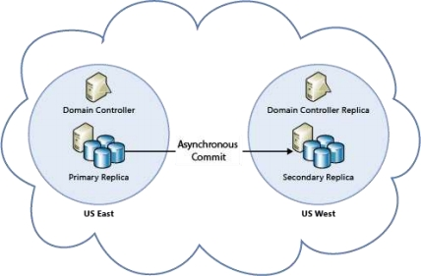
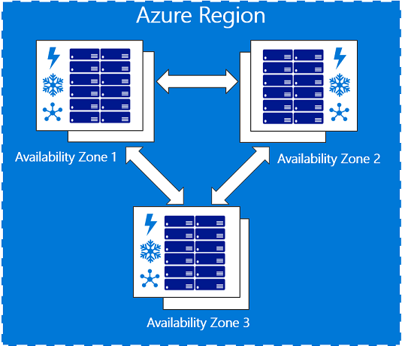
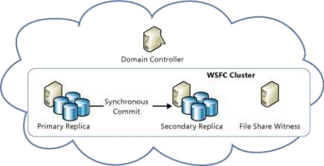
Always On Availability Groups
All availability replicas running in Azure VMs for high availability within the same region. You need to configure a domain controller VM, because Windows Server Failover Clustering (WSFC) requires an Active Directory domain. For more information, see Configure Always On Availability Groups in Azure (GUI).
Availability replicas running across multiple datacenters in Azure VMs for disaster recovery . This cross-region solution protects against complete site outage.
Availability replicas running on the same region
(but across different availability zones in Azure VMs
(Not available on all datacenters (Link))

Slide 5
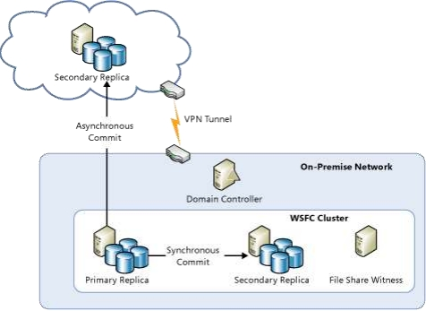
Always On Availability Groups (Hybrid)
Some availability replicas running in Azure VMs and other replicas running on-premises for cross-site disaster recovery. The production site can be either on-premises or in an Azure datacenter.
Azure Only
Availability replicas
running across
multiple Azure
regions in Azure VMs
for disaster recovery.
Cross-region solution
protects against
complete site outage.
Replicas running in
same Azure Region
for HA.
Hybrid
Some availability
replicas running in
Azure VMs and other
replicas running on-
premises for cross-
site disaster recovery.
Because all availability replicas must be in the same WSFC cluster, the WSFC cluster must span both networks (a multi- subnet WSFC cluster). This configuration requires a VPN connection between Azure and the on-premises network.
For successful disaster recovery of your databases, you should also install a replica domain controller at the disaster recovery site.
It is possible to use the Add Replica Wizard in SSMS to add an Azure replica to an existing Always On Availability Group. For more information, see Tutorial: Extend your Always On Availability Group to Azure.

Slide 6
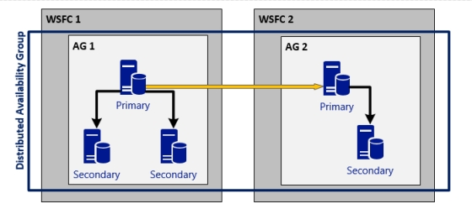
Distributed Always On Availability Groups
Azure Only
Availability replicas
running across
multiple Azure
regions in Azure VMs
for disaster recovery.
Cross-region solution
protects against
complete site outage.
Replicas running in
same Azure Region
for HA.
Hybrid
Some availability
replicas running in
Azure VMs and other
replicas running on-
premises for cross-
site disaster recovery.
Distributed Availability Groups differ from an availability group on a single Windows Server Failover Cluster in the following ways:
Pros
• Each WSFC maintains its own quorum mode and node voting configuration. This means that the health of the secondary WSFC does not affect the primary WSFC
• The data is sent one time over the network to the secondary WSFC and then replicated within that cluster. In a single WSFC, the data is sent individually to each replica. For a geographically dispersed secondary site, distributed availability groups are more efficient
• The operating system version used on the primary and secondary clusters can differ. In a single WSFC, all servers must be on the same version of the OS. This has the potential to use Distributed Availability Groups with rolling updates/upgrades of the operating system
Cons
• The primary and secondary availability groups must have the same configuration of databases
• Automatic failover to the secondary availability group is not supported
• The secondary availability group is read-only

Slide 7
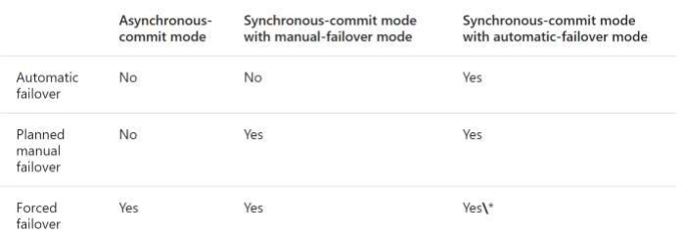
Always On Availability Groups failover modes
•
Primary role and secondary role of availability replicas are interchangeable
•
A secondary replica will be the failover target
•
Database level issues (i.e. database deletion, corrupted transaction log) do not cause an availability group to failover
•
During the failover, the failover target takes over the primary role, recovers its databases, and brings them online as the new primary databases. The former primary replica, when available, switches to the secondary role, and its databases become secondary databases.
Three forms of failover:
•
Automatic failover: No data loss
•
Planned manual failover: No data loss
•
Forced manual failover: Also called forced failover. With possible data loss
\*If you issue a forced failover command on a synchronized secondary replica, the secondary replica behaves the same as for a manual failover

Slide 8
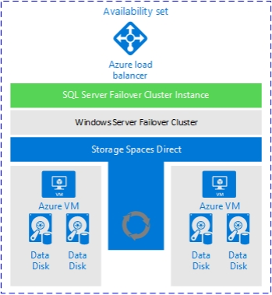
Always On Failover Cluster Instances (FCI)
HA only, not DR
FCI on a two-node
WSFC running in
Azure VMs with
storage supported by
storage spaces direct.
You can use FCI to host an availability
replica for an
availability group
Windows Server 2016 Storage Spaces Direct (S2D) provides virtual shared storage on top of the disks attached to the VMs hosting the FCI replicas by replicating the disk contents.
New -> Premium file share on Azure virtual machines

Slide 9
Basic Availability Groups
Basic Availability Groups replaces the deprecated Database Mirroring feature, providing a similar level of features and is used for SQL Server 2016 Standard Edition (normal Availability Groups requires Enterprise Edition).
Limitations:
• Limit of two replicas (primary and secondary)
• No read access on secondary replica
• No backups on secondary replica
• No support for adding or removing a replica to an existing basic availability group
• Support for one availability database
• Basic availability groups cannot be upgraded to advanced availability groups. The group must be dropped and re-added to a group that contains servers running only SQL Server 2016 Enterprise Edition
• Basic availability groups are only supported for Standard Edition servers

Slide 10
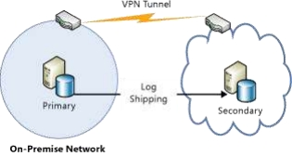
Log Shipping (Hybrid)
For DR only /
Hybrid only
One server running in an Azure VM and the other running on-
premises for cross-
site disaster recovery.
Log shipping
depends on Windows file sharing, so a VPN connection between
the Azure virtual
network and the on-
premises network is
required.
Requires AD
deployment on DR
site.

Slide 11
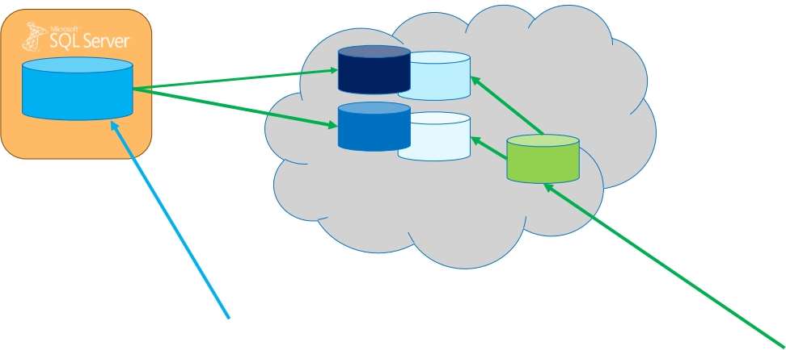
Backup to Azure with file snapshots
Database
Instance
MDF
MDF
LDF
BAK
LDF
Azure Storage
BACKUP DATABASE database TO
URL = N'https://<account>.blob.core.windows.net/<container>/<backupfileblob1>‘ WITH FILE_SNAPSHOT
Hybrid solutions

Slide 12
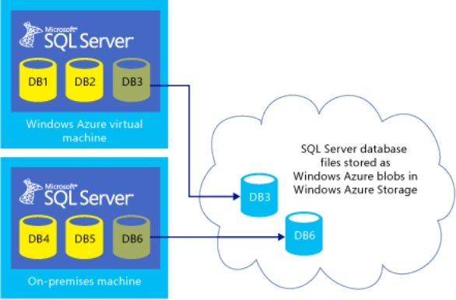
SQL Server data files in Azure (Hybrid)
Native support for
SQL Server data files
stored as Azure blobs
- Easy and fast migration benefits
- Cost and limitless storage benefits
- High availability and
disaster recovery benefits
- Security benefits
- Snapshot backup

Slide 13
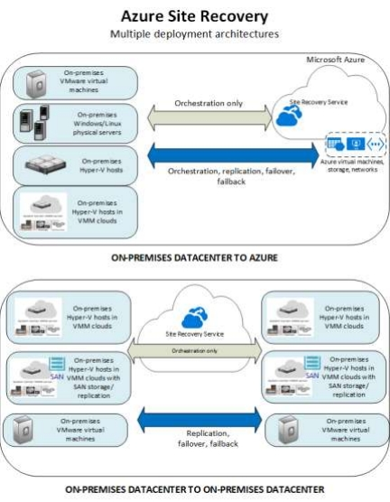
Azure Site Recovery (Hybrid)
SQL Server on-prem DR example: Standalone SQL Server instance
Simpler BCDR story
Site Recovery makes
it easy to handle
replication, failover
and recovery for your
on-premises
workloads and
applications (not
data!).
Flexible replication
You can replicate on-
premises servers,
Hyper-V virtual
machines, and
VMware virtual
machines.
Eliminate the need
for secondary
residing on-premises and replicating to an Azure Storage account by using Azure Site Recovery. The replication targets are page blobs containing the vhd files (C drive) of Azure IaaS virtual machines hosting SQL Server instances that are brought online during failover.

Slide 14
Demo Availability group, load balancer and use databases with blob storage

Slide 15
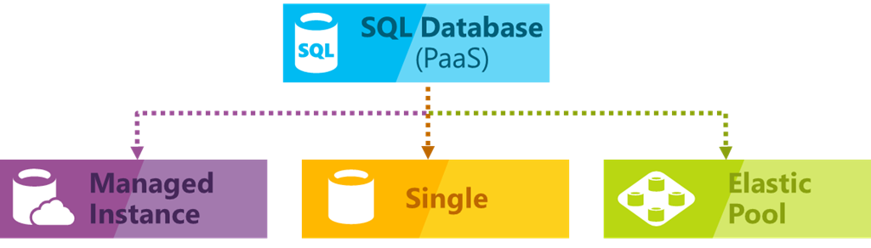
Introduction to SQL Azure DB
Concept:
SQL Database is a general-purpose relational database service in Microsoft Azure that supports structures
such as relational data, JSON, spatial, and XML. It delivers dynamically scalable performance and provides
options such as columnstore indexes for extreme analytic analysis and reporting, and in-memory OLTP for
extreme transactional processing. Microsoft handles all patching and updating of the SQL code base
seamlessly and abstracts away all management of the underlying infrastructure.

Slide 16
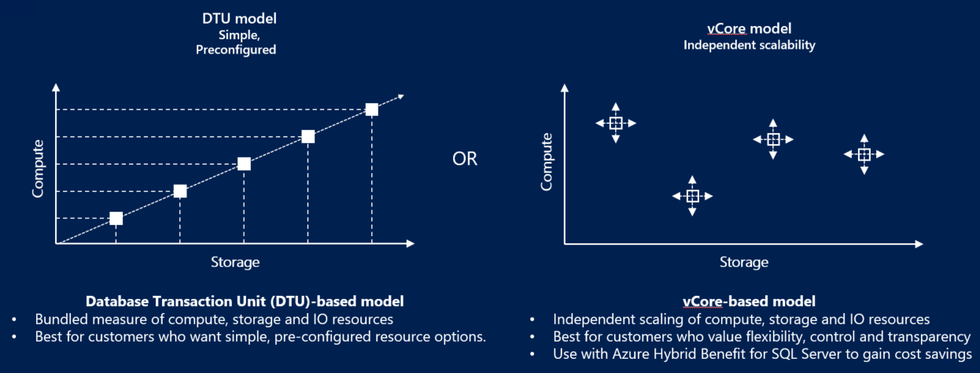
Azure Relational Offerings
Purchasing Models

Slide 17
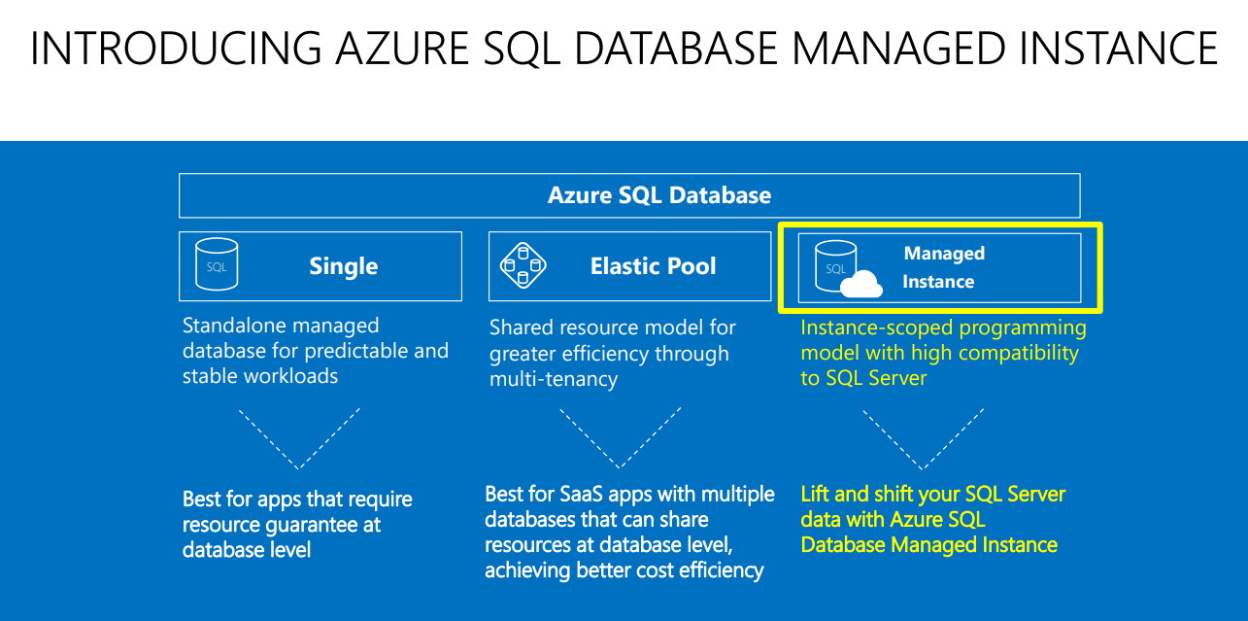

Slide 18
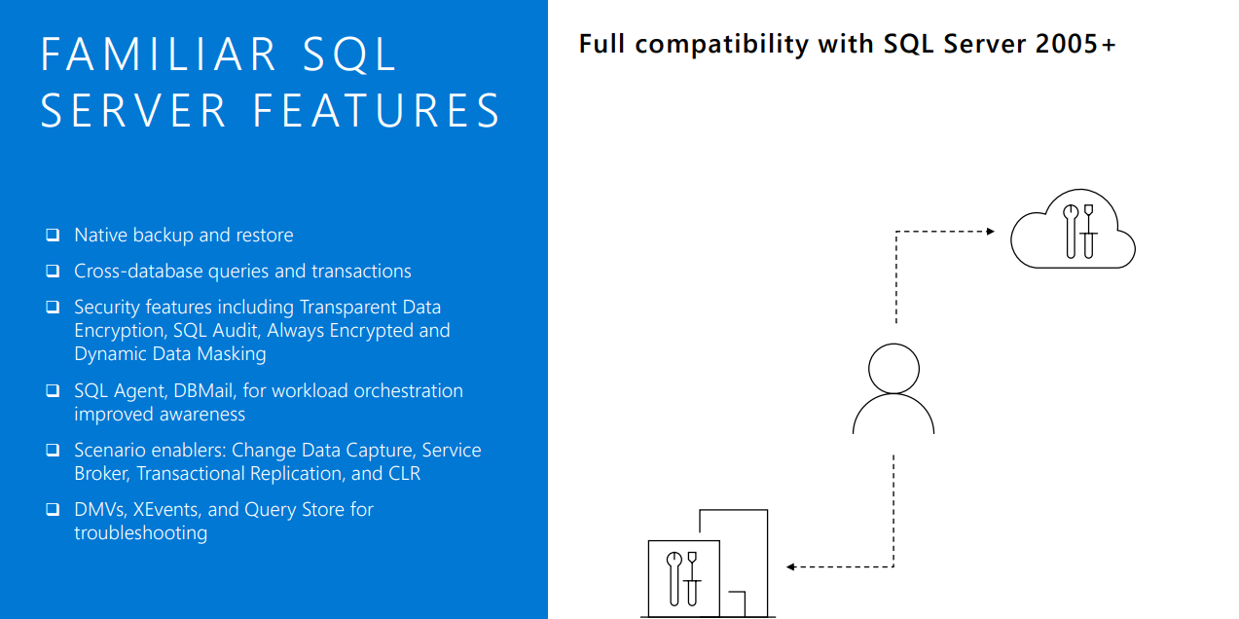

Slide 19
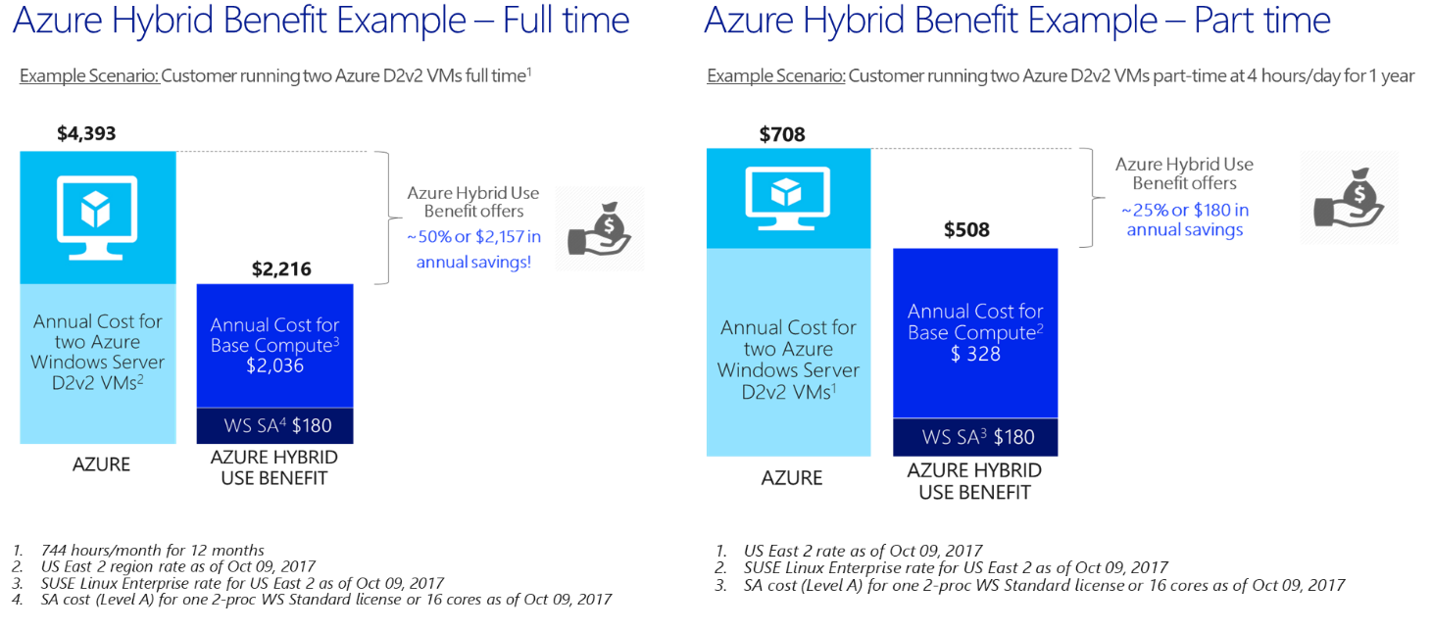
Azure hybrid Benefit!!
VM – Azure SQL DB (Only Vcore!) – Azure SQL DB Manged Instance

Slide 20
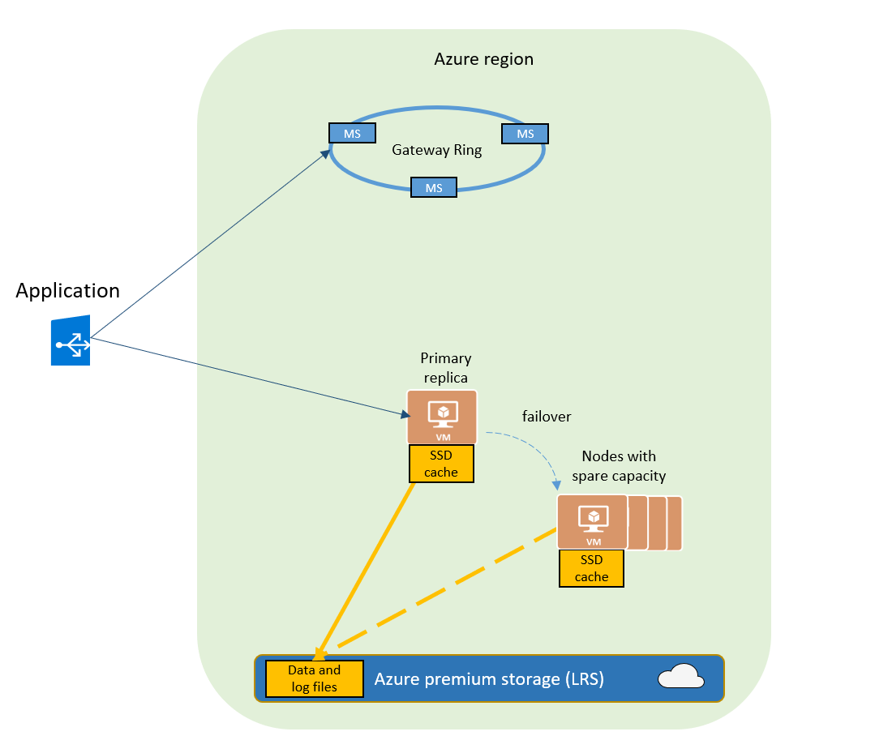
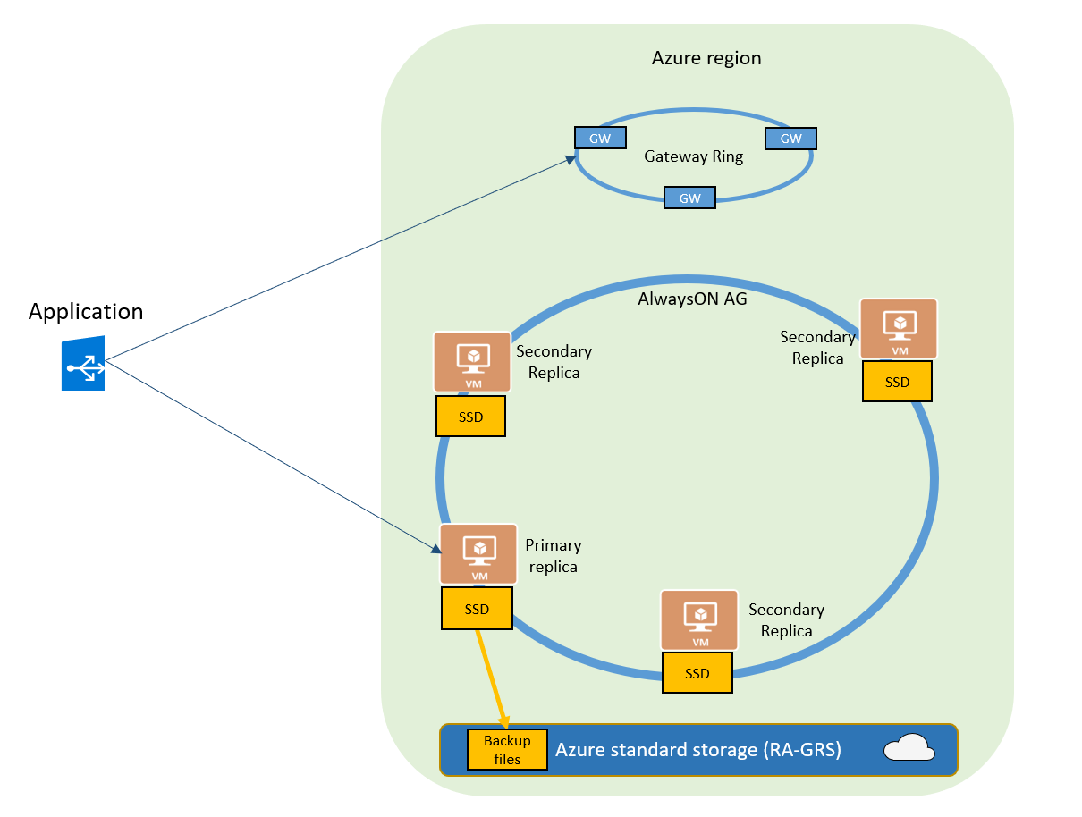
HA by default in Azure SQL DB and Azure SQL DB Managed instance
Basic/Standard/General purpose
Premium/BusinessCritical/ Hyperscale

Slide 21
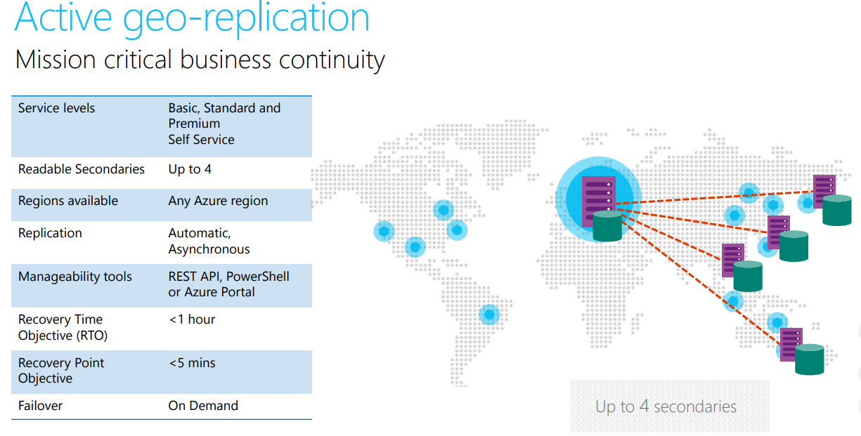
Introduction to Geo Replication (Only Azure SQL DB!!)

Slide 22
Demo Geo replication and HA by default

Slide 23
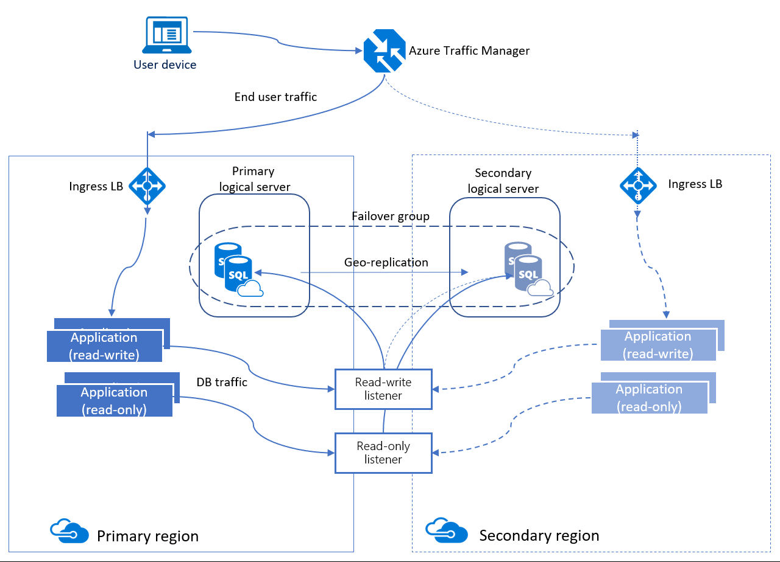
Introduction to Auto-Failover Group
A SQL Database feature that allows you to manage replication and failover of a group of databases on a SQL Database server or all databases in a managed instance to another region. It uses the same underlying technology as active geo-replication. You can initiate failover manually or you can delegate it to the SQL Database service based on a user-defined policy.

Slide 24
Introduction to Auto-Failover Group
Components:
Failover group read-write listener
A DNS CNAME record formed that points to the current primary's URL. It allows the read-write SQL applications
to transparently reconnect to the primary database when the primary changes after failover
Failover group read-only listener
A DNS CNAME record formed that points to the read-only listener that points to the secondary's URL. It allows
the read-only SQL applications to transparently connect to
the secondary using the specified load-balancing rules.

Slide 25
Introduction to Auto-Failover Group
Components:
Grace period with data loss
Because the primary and secondary databases are synchronized using asynchronous replication, the failover may result in data loss. You can customize the automatic failover policy to reflect your application’s tolerance to data loss. By configuring GracePeriodWithDataLossHours, you can control how long the system waits before initiating the failover that is likely to result data loss.

Slide 26
Introduction to Auto-Failover Group
Components:
Read-only failover policy
By default, the failover of the read-only listener is disabled. It ensures that the performance of the primary is not impacted when the secondary is offline. However, it also means the read-only sessions will not be able to connect until the secondary is recovered. Only this can be enabled through powershell (this option is not yet supported).
Script:
(Install AZ Module from Here)
New-AzSqlDatabaseFailoverGroup -ResourceGroupName rgname -ServerName server1 -PartnerResourceGroupName rgname2 -PartnerServerName server2 -FailoverGroupName AGname -FailoverPolicy automatic -AllowReadOnlyFailoverToPrimary enabled

Slide 27
Introduction to Auto-Failover Group
Capabilities:
Planned failover
Planned failover performs full synchronization between primary and secondary databases before the secondary switches to the primary role. This guarantees no data loss.
Unplanned failover
Unplanned or forced failover immediately switches the secondary to the primary role without any synchronization with the primary.
This operation will result in data loss.

Slide 28
Considerations and reccomendations
Same database tier on both replicas!
The replicas must be on the same subscription
OUTAGE = DATA LOSS!
Auto-failover group will support only one replica
Secondary replica cannot be on the same región as the primary
The DB you add on the auto-failover group cannot exist on the secondary
Both logical server must be on the same subscription
Log rate limit vcore model limitation will not be impacted if you use auto-failover group -> Here
Check Firewall rules on both sides! They will not be replicated as well as sql logins!
Check azure services status -> Here
Check azure History issues and RCAs -> Here

Slide 29
Architecture examples
1) Auto-Failover group with a single replica without geo replication or multiple groups

Slide 30
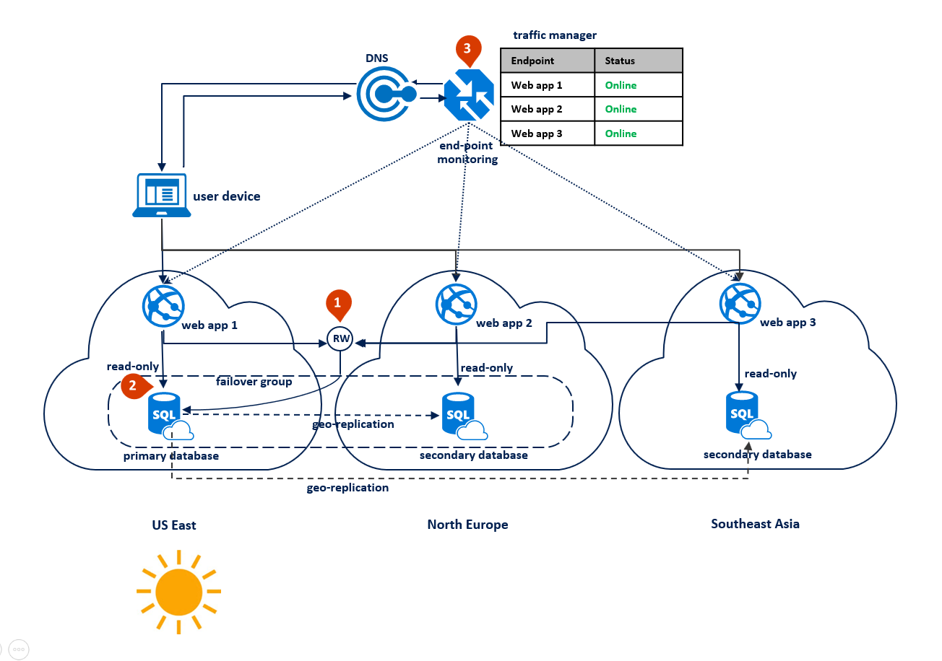
Architecture examples
2) Auto-Failover group with a single replica plus geo replication to query different destinations

Slide 31
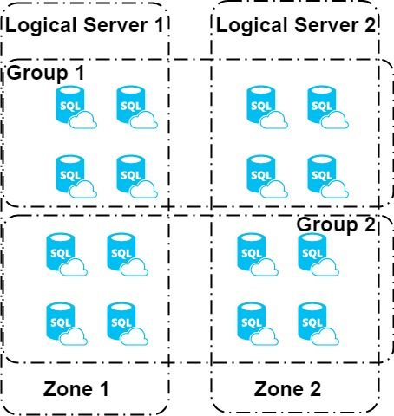
Architecture examples
3) Multiple Auto-Failover group with different databases in order to alleviate the impact on an outage

Slide 32
Architecture examples
3) Multiple Auto-Failover group with different databases in order to alleviate the impact on an outage

Slide 33
Demo Auto Failover Groups

Slide 34
Final Questions

Slide 35

Thank you!!!!!!!

